Slide 1
Introduction to Impact Evaluations Subtitle
XX instructor name
Your title, 3ie
APHRC Virtual Training Session
Session 1 - Introduction
XX date

Slide 2
Who we are & what we do
3ie is a member-based international NGO promoting evidence-informed development policies and programmes.
Grant maker and standard setter for policy-relevant impact evaluations, systematic reviews, evidence gap maps, evidence syntheses and replication studies focussed on low- and middle-income countries
Convener of forums to build a culture of evaluation, capacity to undertake impact evaluations and reviews and commitment to evidence-informed decision-making
Producer of knowledge products for policymakers, programme managers, researchers, civil society,
the media and donors
Notes:
3ie is a member-based international NGO established in 2008, promoting evidence-informed development policies and programmes. As an organisation, we believe evidence-informed decision-making will make development more effective and help improve the lives of poor people.
Note: We are an NGO registered in the US. We have offices in Delhi, London and Washington, DC. You CANNOT say that Delhi is our main or head office for legal reasons.
The points below provide details you can use to describe 3ie while using this slide.
Please remember: What you say should be tailored to your specific audience. How you expand on what 3ie does should depend on your audience and the context or purpose of your presentation at that particular meeting. The description in the ‘Who we are’ slide is the minimum required to describe 3ie at the start of every presentation. This one slide should take approximately 30 seconds to a minute to paraphrase. You can change the order of the information. However, you should not forget to mention that we are primarily a funder, even if you choose to emphasise other aspects of what we do. You can choose to include more slides with further details on our work. We encourage you to decide how much detail to include depending on the audience and the time available for the presentation.
Given below some suggestions for more details that can be added to your slides:
We are primarily a grant maker set up by major development donors to help fill the large gaps in quality evidence available for international development decision-making.
We fund impact evaluations, systematic reviews, evidence syntheses (such as the 2013 study on education outcomes and the forthcoming paper on community-driven development evidence) evidence gap maps and replication studies focused on low- and middle-income countries.
We set high standards in terms of our grant making. We fund experimental and quasi-experimental impact evaluations that are policy-relevant, use innovative approaches, are gender responsive and equity focussed. We fund mixed-method studies that draw on quantitative and qualitative research and answer the question of what works, what doesn’t, for whom, how and at what cost. We are alsoleaders in funding and producing systematic reviews.
At the end of December 2015, 3ie had funded 174 impact evaluations in 58 countries. We had also funded 38 systematic reviews and 16 replication studies in international development. (Please make sure you get updated numbers. We update before each board meeting, for the annual reporting (these are the numbers as of the end of December each year) and before DFID’s annual review, usually in August. You can get updated numbers from Ditto or Deeksha.
We convene forums for building the capacity for evaluation and for promoting conversations and collaborations between researchers, programme managers and policymakers. We organise international conferences, seminars and workshops around various aspects of impact evaluations. We also have a significant online presence for sustained and deep engagement with our stakeholders. We engage very closely with our members who form a diverse community united by the commitment to use evidence for the improvement of development policies and programmes. Our members are public and private donors, NGOs, and government agencies from low- and middle-income countries.
We produce a range of knowledge products:
--scoping papers and evidence gap maps that inform how we develop and fund our grant-making and determine funding priorities for the organisation.
-- impact evaluation report series
--systematic reviews and systematic review summary series
--replication report series
--expert guidance and resources for each of our main audiences
We also maintain and update the following databases:
--The Impact Evaluation Repository, which is the world's largest repository of high-quality impact evaluations. It will also include impact evaluations in languages other than English.
--A growing database of systematic reviews of international development evidence.
-- An impact evaluation registry
You can also mention that the 3ie website is our primary mode of communication and engagement with various audiences, including our members, other stakeholders and public at large. 3ie’s blog is called Evidence Matters.

Slide 3
Course objectives
XX blah

Slide 4
Modules at a glance
Week 1: Introduction to impact evaluation
Week 2: Experimental designs – Randomised Control Trials
Week 3: Quasi-experimental designs

Slide 5
Weekly Schedule
Monday
Module pre-test
2 hr. webinar to present module content
Tuesday
Self-directed study, including: 1) Case studies; 2) Hands-on exercise
Wednesday
Self-directed study
Thursday
Friday
Hands-on exercise assigned
Participants submit questions to facilitators by COB local time
Self-directed study
Submit hands-on exercise by COB local time
1 hr. webinar for Q&A, including: 1) submitted questions; 2) hands-on exercise; 3) assessment answers
Module post-test
Virtual “office hours”

Slide 6
Session agenda
Time | Agenda item
10 min | Welcome and introductions
5 min | Overview of workshop objectives and weekly schedule
40 min | 1st Session: 1.1 Why evaluate? Value proposition(s) for IE 1.2 Causal attribution and the counterfactual 1.3 IE vs M&E 1.4 Theory of change
10 min | BREAK
30 min | 2nd Session: 1.5 Research designs and methods 1.5.1 Experimental designs 1.5.2 Quasi-experimental designs 1.5.3 Mixed methods 1.6 Planning considerations for impact evaluations
10 min | Presentation of self-directed study, including: Case studies Hands-on exercise
10 min | Questions/clarifications and closing
Notes:
Instructions for reading the notes:
The accompanying notes provide explanation for the slides and illustrate them with examples.
In several places, you are asked to answer questions such as WHY and HOW. Similarly, you are asked to think of an example from your work. Answer the questions before continue reading further. Answers are provided in the same or next slides / notes.

Slide 7
Why Evaluate?
1.1
E.g. increasing enrolment in schools:
supply side is the problem: build more school buildings and hire more teachers
demand side problems: provide books, uniforms, meals, etc. to reduce the cost of going to schools
what else: deworming worked better than anything else; but it is not context neutral
Evaluation is key to figure out what approaches are working and why, and what contextual factors are critical to achieving desired outcomes.

Slide 8
Why Evaluate…
1.1
Inform budget allocations
To continue, expand or reduce budget allocation to a programme
Convincing the citizens that the investments have positive returns
Political Sustainability (or break with “bad” policies of past)
E.g Progresa / Oportunidades Conditional Cash Transfer Program in Mexico
South Africa Youth Subsidy programme
Improve Resource Allocations
E.g Family Planning and Fertility in Indonesia

Slide 9







What do we mean by impact evaluation?
1.2
Quantify changes in targeted outcomes that are attributable to the intervention (i.e., would not have otherwise happened)
Fundamental problem of causal inference
Outcome
vs.
With intervention
?
Without intervention
Time
Notes:
Key messages for this slide (follows along with animation):
Here we want to clarify what we mean by impact evaluation to make sure we’re all on the same page. This will already be familiar to some of you, so I will keep it brief.
The group on the left represents our target population. We want to measure the impact of a particular impact on this group.
Ideally, we’d like to be able to compare outcomes for this group when they receive the intervention (blue outline) to the same group if they didn’t receive the intervention (orange outline) (i.e., the counterfactual).
Unfortunately, we can’t observe both at the same time, which is the fundamental problem of causal inference.
So we end up comparing outcomes between different groups of people. Consequently, we have to try to manage selection bias in order to make sure we are comparing “apples with apples” to the maximum extent possible.

Slide 10
What is Impact Evaluation
1.2
The holy grail statement:
A xx program caused an x% increase (amount of change and direction of change) in the outcome for the beneficiaries.
Notes:
How do we know if the programme was responsible for the change in the outcome? For ex, after a job training, a trainee’s income might have gone up, but it could be attributed to her effort, benign market conditions or numerous other factors.
How do we identify the change attributable only to the programme?

Slide 11
Prospective vs retrospective IE
1.2
Prospective IE
Begins at the design phase and information is collected to assess the impact of the program. Information is collected from the beneficiaries and non-beneficiaries before and after the intervention occurs.
Retrospective IE
These are conducted after the implementation has been completed. These evaluations exploit existing data sets and collect information close to the existing dataset post implementation for better comparability.

Slide 12
What is the difference between M&E and IE?
1.3
Monitoring & Process Evaluation
Is programme targeting the right beneficiaries and implemented as efficiently as planned?
Impact Evaluation
What was the change in the outcome that could be attributed to the programme?
If there are alternative programme designs are available which one has the highest impact? Which one is the most cost-effective?
Is there any heterogeneity in impact (e.g. females, poor, minorities)?

Slide 13
M&E vs. IE…
1.3
 | Monitoring | Impact Evaluation
Frequency | Regular, continuous | Periodic
Coverage | All programmes | Selected programmes, aspects
Data | Universal | Sample based
Depth of information | Tracks implementation, looks at what | Tailored, often to performance and impact/WHY
Cost | Cost spread out | Can be high
Utility | Continuous programme improvement, management | Major programme decisions

Slide 14
What is a ToC?
1.4
Describes how an intervention is supposed to deliver the desired results
Provides the causal logic of how and why a particular project, program, or policy will reach its intended outcomes in a given context
Spells out the conditions and assumptions needed for the change to take place

Slide 15
Why do we need it?
1.4
To develop a causal pathway to identify necessary and sufficient outcomes needed to achieve a goal
To develop a roadmap that shows how a set of actions would help achieve a goal
To identify and highlight interventions and assumptions that are critical to produce an outcome
To identify critical areas addressed by external actors and how the project will link to them

Slide 16
Elements of ToC
1.4
Inputs: Resources at the disposal of the project, including staff and budget
Activities: Actions taken or work performed to convert inputs into outputs
Outputs: The tangible goods and services that the project activities produce (They are directly under the control of the implementing agency.)
Outcomes: Results likely to be achieved once the beneficiary population uses the project outputs (They are usually achieved in the short-to-medium term.)
Final outcomes: The final project goals (They can be influenced by multiple factors and are typically achieved over a longer period of time.)
Assumptions and risks include any evidence from the literature on the conditions under which the hypothesised causal logical will hold.

Slide 17

Theory of Change: School vouchers
1.4
Students gain more knowledge in private schools than they would in public
Voucher Scheme Established
Students Attend Private School
Higher test scores
Better life (income etc.)

Slide 18
1.4
Transmission route and assumptions
Voucher Scheme Established
Students Attend Private School
Effective targeting mechanism
Parents know about the programme
Children do not drop out in favor of employment, housework, etc.
Vouchers distributed
Vouchers provide sufficient incentive for private school attendance
Students attend class
Students/parents do not prefer to keep children in public school; e.g. due to distance, discrimination, etc.

Slide 19
1.4
Transmission route and assumptions…
Students gain more knowledge in private schools than they would in public
Students Attend Private School
Smaller student/teacher ratio
More parental involvement
Better discipline
Private schools are better
Higher performing classmates
More training
Better teachers
Better facilities – toilets, water, fans, desks, chalkboards, etc.
Better motivated and monitored
Teacher attendance

Slide 20
1.4
Transmission route and assumptions…
Students gain more knowledge in private schools than they would in public
Higher test scores
Home environment conducive to studying
Parents can afford extra classes
Test accurately measures student knowledge

Slide 21
Transmission route and assumptions…
1.4
Higher test scores
Better life (income etc.)
Test scores are valued by employers
Meritocracy in hiring
Education imparts other life skills

Slide 22
How do we measure what works?
Quantify changes in targeted outcomes that are attributable to the intervention (i.e., would not have otherwise happened)
Seek to understand and describe why, how, and in what contexts those changes occur, learn about unmeasured factors
Context (e.g., social, political, economic)
Motivations
Experiences
Unintended consequences
Complexity
Etc.
Outcome
vs.
With intervention
?
Without intervention
Time
Notes:
We also seek to understand and describe why, how, and in what contexts those changes occur.

Slide 23
Impact Evaluation
What is the impact, or causal effect, of a program on an outcome of interest?
The change observed in an outcome should be attributable only to the program
Causality
How to find a good counterfactual?

Slide 24






Impact Evaluation
What is a counterfactual?
An estimate of what the outcome (Y) would have been for a program participant in the absence of the program (P).
A valid comparison group has, on average, the same characteristics as the treatment group; EXPECT for the fact that the treatment group has received the program

Slide 25
Impact Evaluations
1.6
Is a given program effective compared to the absence of the program?
How can Impact Evaluations inform policy makers?
When a program can be implemented in several ways, which one is the most effective?

Slide 26
Impact Evaluations
1.6
Is the project innovative?
Can the project be replicable?
When to evaluate a program?
Is the research question filling a knowledge gap?
Are the results relevant for policy makers?

Slide 27
Impact Evaluations
1.6
Which elements of the program matter the most?
Are results transferable from one context to another?
Is better to address all problems simultaneously or one at a time?
Which Questions Need an Impact Evaluation?
What is the impact of the program?
Which elements of the program matter the most?
Which of two alternative strategies brings more benefits?

Slide 28
SUTVA: Stable Unit Treatment Values Assumption
No interference. An individual’s potential outcomes are not affected by other individuals’ exposure to treatment
For each individual, there is a single version of treatment. (potential outcomes must be well defined
Notes:
SUTVA requires that the response of a particular unit depends only on the treatment to which he himself was assigned, not the treatments of others around him.
Think of examples for which each component does not hold:
Students assigned to attend a tutoring program to improve their grades might interact with other students in their school who were not assigned to the tutoring program and influence the grades of these control students. To enable causal inference, the analysis might be completed at the school level rather than the individual level.

Slide 29
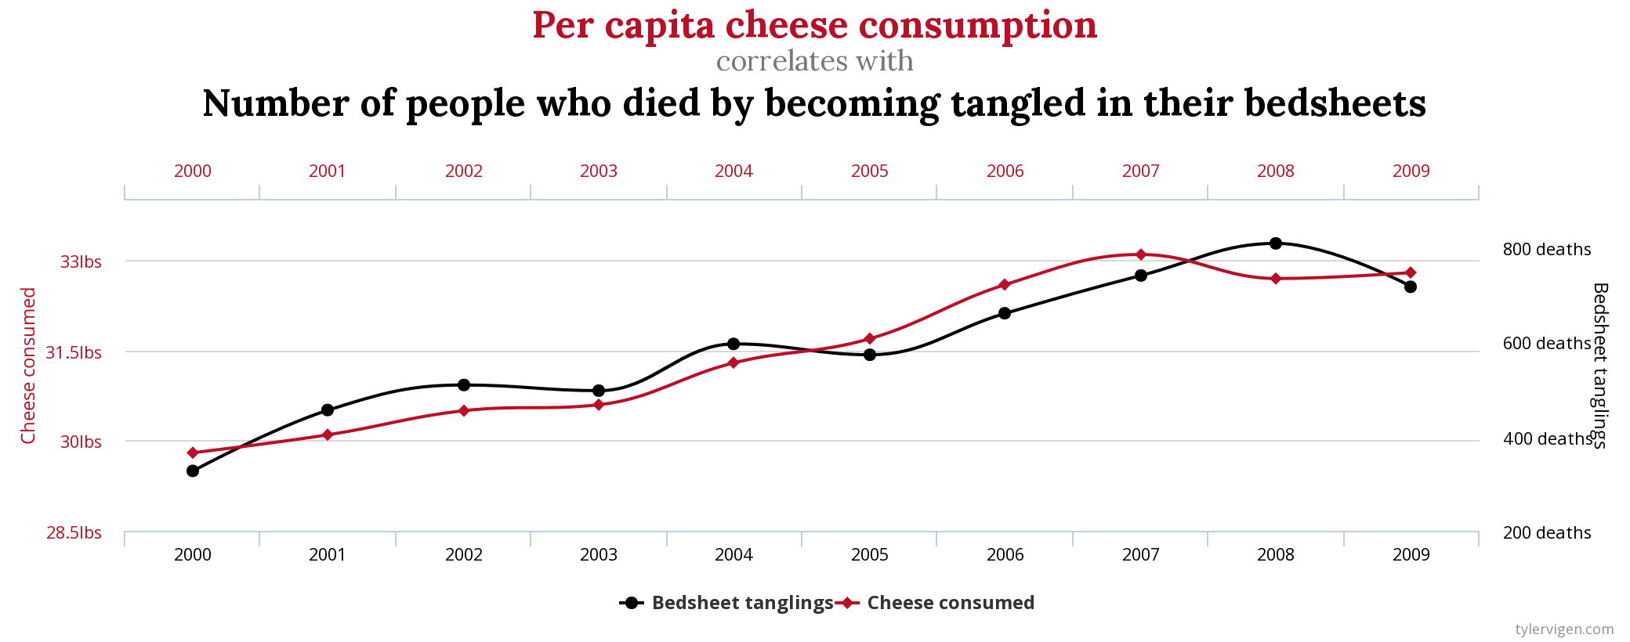
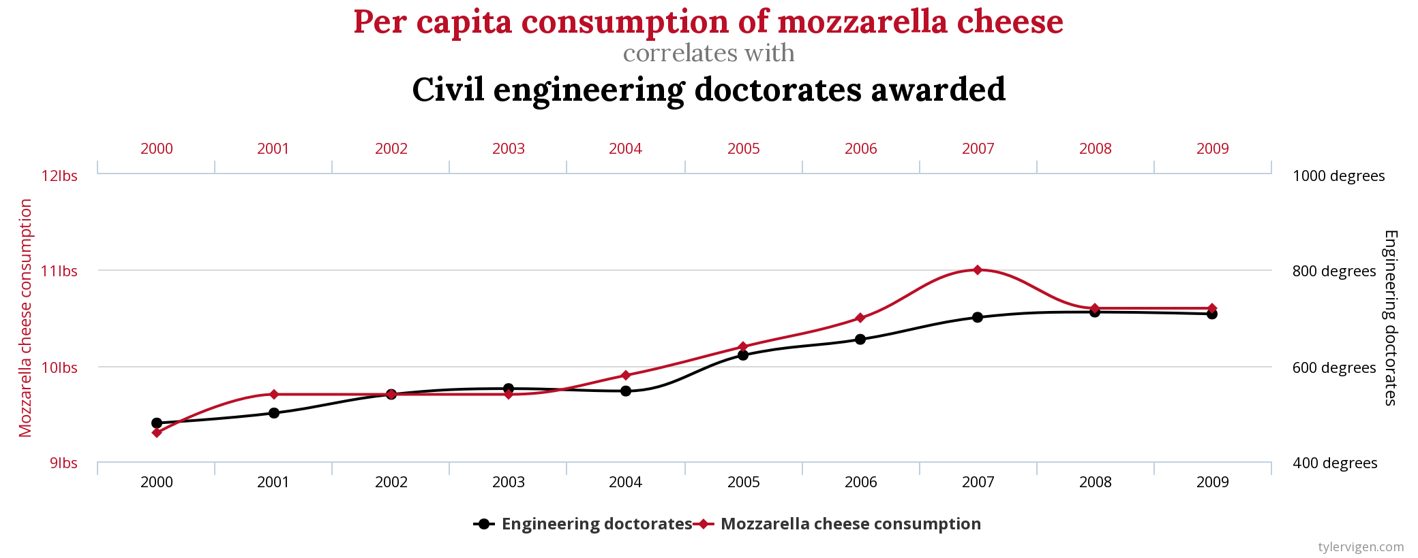
Correlation does not mean causation
1.2
(suggested)
Notes:
Correlation does not mean causation.
In both these examples the variables are highly correlated, but there is no explainable cause and effect relationship between them.
In the absence of experimental evidence, it is very difficult to know whether the higher earnings observed better-educated workers are caused by their higher education, or whether individuals with greater earning capacity have chosen to acquire more schooling.
— David Card, The causal effect of education in earnings
To say X causes Y, we need to be sure that there aren’t any other confounding factors that can make the relationship endogenous.

Slide 30
The big IE question (3 ways)
How do I know my programme caused observed changes in outcomes?
To what extent can I attribute observed changes in outcomes to my programme?
Would the changes I observed in outcomes have occurred in the absence of my programme?
→ Impact evaluation (IE) is way to answer these questions, providing causal evidence

Slide 31
The big IE question (3 ways)
How do I know my programme caused observed changes in outcomes?
To what extent can I attribute observed changes in outcomes to my programme?
Would the changes I observed in outcomes have occurred in the absence of my programme?
→ Impact evaluation (IE) is way to answer these questions, providing causal evidence

Slide 32
The big IE question (3 ways)
How do I know my programme caused observed changes in outcomes?
To what extent can I attribute observed changes in outcomes to my programme?
Would the changes I observed in outcomes have occurred in the absence of my programme?
→ Impact evaluation (IE) is way to answer these questions, providing causal evidence

Slide 33
The other big question
How was my morning today?
If I had a good morning, would I know what caused it?
Working hypothesis: wearing a particular shawl causes me to have a good morning, i.e., any morning I wear the shawl will be good

Slide 34
The hypothesis
1 January 2014
Wear shawl
Quality of my day = good

Slide 35


The counterfactual
1 January 2014
Wear shawl
Quality of my day = good
Factual (if I am wearing the shawl!)

Slide 36
The counterfactual
1 January 2014
1 January 2014
Wear shawl
Do not wear shawl
Quality of my day = good
Quality of my day = ?
Factual (if I am wearing the shawl!)
Counterfactual

Slide 37
The counterfactual
1 January 2014
1 January 2014
Wear shawl
Same day
Same wake-up time
Same outside temperature
Same breakfast
Same shower temperature
Same outfit…
SAME, except for shawl
Do not wear shawl
Quality of my day = good
Quality of my day = ?
Factual (if I am wearing the shawl!)
Counterfactual

Slide 38
Impact evaluator’s dilemma
Want to observe something that can never be observed!
Want to compare the factual (what happened) with the counterfactual (what would have happened) to assess attribution.
Attribution is a comparative question.

Slide 39
What to do?
Approximate the counterfactual through a comparison group
Impact evaluation seeks to answer a causal or attribution question by using a comparison group.
Trick lies in constructing a comparison group that convincingly mimics the (unobservable) counterfactual.

Slide 40
Creating the comparison group
Coming up with a way to approximate the counterfactual
Relates to how the programme will be allocated, not what kinds of data will be collected or the sampling strategy.
Examples:
Random allocation
Matched allocation
Making use of a cut-off (“discontinuity”) in evaluation

Slide 41
Ethics of a comparison group
1. Do we already know how much benefit is derived from an intervention and at what cost of delivery in a relevant context (i.e. what do we know about effectiveness)?
If no, then a study design involving a (no-intervention) comparison group may be ethical, to answer this question before scaling up.
2. Do we already know how well an intervention will work in a given context (i.e. the one in which we propose an evaluation)?
If no, then a study design involving a comparison group may indeed be ethical, before using resources to scale-up the intervention.
3. Do resources exist to roll-out the intervention to the entire population right now?
If no, then a randomization procedure may be more ethical to determine who will get the intervention ‘later’ than alternative selection criteria, such as political favoritism.

Slide 42
Ethics of a comparison group
1. Do we already know how much benefit is derived from an intervention and at what cost of delivery in a relevant context (i.e. what do we know about effectiveness)?
If no, then a study design involving a (no-intervention) comparison group may be ethical, to answer this question before scaling up.
2. Do we already know how well an intervention will work in a given context (i.e. the one in which we propose an evaluation)?
If no, then a study design involving a comparison group may indeed be ethical, before using resources to scale-up the intervention.
3. Do resources exist to roll-out the intervention to the entire population right now?
If no, then a randomization procedure may be more ethical to determine who will get the intervention ‘later’ than alternative selection criteria, such as political favoritism.

Slide 43
Ethics of a comparison group
1. Do we already know how much benefit is derived from an intervention and at what cost of delivery in a relevant context (i.e. what do we know about effectiveness)?
If no, then a study design involving a (no-intervention) comparison group may be ethical, to answer this question before scaling up.
2. Do we already know how well an intervention will work in a given context (i.e. the one in which we propose an evaluation)?
If no, then a study design involving a comparison group may indeed be ethical, before using resources to scale-up the intervention.
3. Do resources exist to roll-out the intervention to the entire population right now?
If no, then a randomization procedure may be more ethical to determine who will get the intervention ‘later’ than alternative selection criteria, such as political favoritism.

Slide 44
Ethics of a comparison group
1. Do we already know how much benefit is derived from an intervention and at what cost of delivery in a relevant context (i.e. what do we know about effectiveness)?
If no, then a study design involving a (no-intervention) comparison group may be ethical, to answer this question before scaling up.
2. Do we already know how well an intervention will work in a given context (i.e. the one in which we propose an evaluation)?
If no, then a study design involving a comparison group may indeed be ethical, before using resources to scale-up the intervention.
3. Do resources exist to roll-out the intervention to the entire population right now?
If no, then a randomization procedure may be more ethical to determine who will get the intervention ‘later’ than alternative selection criteria, such as political favoritism.

Slide 45
How do we measure what works?
1.2
Quantify changes in targeted outcomes that are attributable to the intervention (i.e., would not have otherwise happened)
Fundamental problem of causal inference
Methods:
-Randomized contr. trials
-Instrumental variables
-Regression discontinuity
-Propensity score matching
-Etc.
Outcome
vs.
With intervention
?
Without intervention
Time
Notes:
Randomized controlled trials are the methodologically “cleanest” way to establish a counterfactual so we can compare “apples with apples”, but this is sometimes impractical or not feasible
A variety of quantitative non-experimental methods address the same fundamental need for comparability:
Difference-in-difference
Instrumental variables
Regression discontinuity
Propensity score matching
Etc.
But these methods only tell part of the story

Slide 46
1.5
Methods Summary
Rigorous impact evaluations use experimental or quasi-experimental methods to construct a counterfactual designed to overcome selection bias and to control for confounding factors.
Experimental design
Randomized controlled trials.
Quasi-experimental design
Control strategies (differences-in-differences and matching)—can be applied when we don’t know the program assignment rules.
Regression discontinuity designs and “natural experiments” exploit haphazard events or randomness in selection processes.

Slide 47
Experimental design: Randomized Control Trials
1.5.1
A “randomized control trial” (RCT) randomly assigns units to “treatment” and “control” and then compares outcomes across these groups.
Different names of RCTs
Experimental evaluation
Random assignment studies
Randomized field trials
Field experiments
Social experiments
Randomized controlled experiments

Slide 48
Quasi-experimental evaluations
1.5.2
Three main classes
“Control strategy” designs operate on the assumption of “selection on observables” to construct a counterfactual comparison group.
“Regression discontinuity” studies exploit situations where programs are assigned based on a cut-off in an index.
“Natural experiment” designs exploit incidental or accidental haphazardness in assignment to approximate randomized experiments.

Slide 49
Qualitative and Mixed methods
1.5.3
Combines the breadth of quantitative evaluation methods with the depth of qualitative evaluation
Offers distinct benefits
Context
Behavioural change
how the project affects different groups
Triangulation

Slide 50
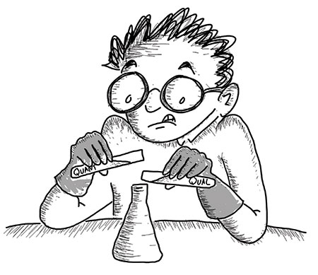
1.5.3
There is growing interest in mixed methods impact evaluations
“QUANT”
“QUAL”
“Mixing these methods should be safe.”
Illustration by Patrick Vinck
https://chance.amstat.org/2018/02/mixed-methods/
Notes:
Key messages for this slide:
There has been a substantial increase in the level of interest and number of publications on mixed methods in the past ten years or so, including empirical papers, theoretical papers, practical guidelines, sample protocols, design typologies, and so forth.
One of the key messages coming out consistently is that “mixed methods” means much more than just adding a quantitative method to a qualitative study or vice versa. Though people sometimes initially think of mixed methods as something that is inherently valuable because you are bringing together different and complementary methods with different strengths and weaknesses – so naturally you’ll end up with more valid or insightful findings. Unfortunately that’s not the case and mixed methods studies are often more difficult, expensive, and time-consuming than single-paradigm studies because you have to ensure rigor with each method and also develop a rigorous design and approach for integrating the methods.
Potential pitfalls: e.g.,
conducting some interviews and focus groups alongside quantitative data collection and then cherry-picking quotes to explain why an effect was observed or why it was not observed (may be partly due inadequate description of the settings, methods used to collect and analyze the data, examining rival hypotheses, looking for negative evidence, no justification for sampling, etc.)
Trying to quantize some qualitative data and then try to test for statistically significant differences between two or more groups in a small sample of data
In short, mixing methods has to be done carefully and requires adequate training.

Slide 51

Valuable experiences and lessons are emerging
1.5.3
E.g., 2018 CEDIL and 3ie “Mixing and matching” report, highlighting:
Good practices for integrating qualitative methods into quantitative impact evaluations and systematic reviews
Examples of specific applications of qualitative evidence in mixed methods impact evaluations
Notes:
Key messages for this slide: This CEDIL/3ie paper reviews recent work done to incorporate qualitative methods in impact eval., brings in expert opinion, outlines lessons for the way forward

Slide 52
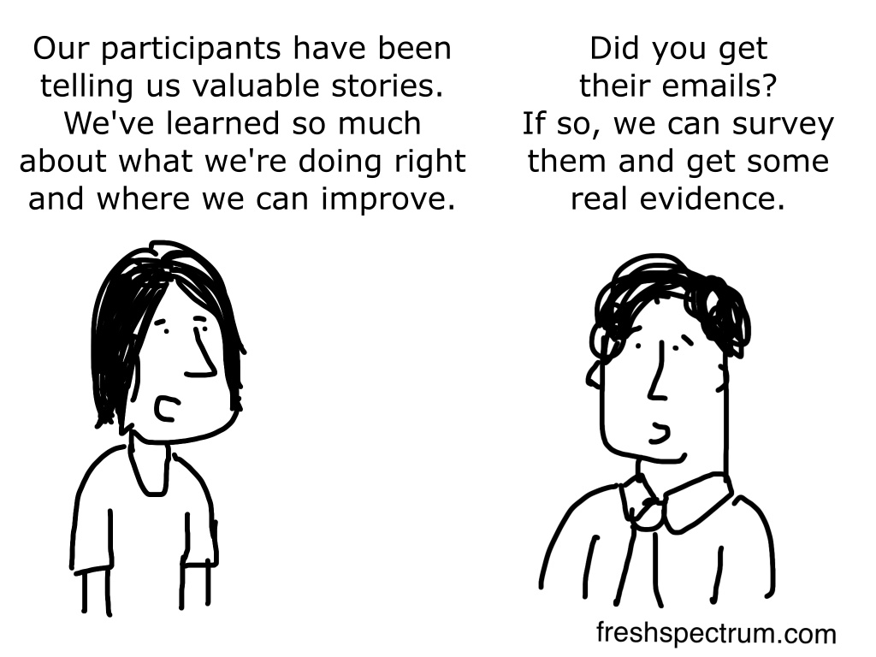
Research is moving beyond outdated perceptions
1.5.3
http://freshspectrum.com/wp-content/uploads/2014/12/Real-Evidence-1024x768.png
Notes:
Key message for this slide: One of the points noted in the introduction of the CEDIL report is that – like this slide - it still unfortunately common for authors to call their quantitative studies “mixed methods” when what all they are actually doing is adding qualitative quotes to justify findings from the quantitative analysis – or to spice up a presentation or report.

Slide 53
Good practices for using qualitative evidence in quantitative impact evaluations
1.5.3
Rigorous application of each method individually
Clear rationale for the integration of methods at key stages of the evaluation
Multidisciplinary teams with a shared evaluation approach
Adequate documentation (e.g., within the main report supplementary reports, appendices, etc.)
Acknowledge limitations of the integration and reflect on the transferability of findings and their policy implications
Notes:
Key messages for this slide: summarize key points from the CEDIL/3ie paper

Slide 54
Applications of qualitative evidence by study phase
1.5.3
Plan
Generate/refine theory
Conduct
Validate or triangulate quantitative findings
Interpret
Add contextual understanding to findings
Inform research questions to be asked
Choose research design, identification strategy
Design data collection approach, instruments
Investigate assumptions (e.g., about the Theory of Change)
Learn about population/beneficiary experiences
Identify heterogeneity, unintended consequences
Formulate better policy recommendations
External validity/transferability to other contexts
Raise new questions to guide future research

Slide 55
Examples from the field
1.5.3
Country | Topic(s) | Qual purpose(s) | Qual method(s) | Contribution
Zambia | Gender, Empowerment | Context, triangulation, critique measures | In-depth interviews | Insights on quant measures of female bargaining power
Bangladesh | Nutrition, Livelihoods | Inform study design | (Reviewing prior) anthropological research | Conduct quantitative analysis with qualitative insight
India | Health | Implementation fidelity, root cause analysis | Focus group discussions, observation, field notes | More nuanced ToC, incl. supply-side constraints, heterogeneity
Vietnam | Gender, Empowerment | Compare beneficiary/ staff views quant v. qual | In-depth interviews, focus group discussions | Beneficiary suggestions for improving intervention design
Mexico | Early child development | Beneficiary perceptions, results interpretation | Interviews, focus group discussions | Insights to refine intervention, improve public understanding
Cambodia | Nutrition | Inform analysis, causal assumptions | Stakeholder interviews, tracer interviews | Alternative perspectives on quant findings
China | Education | Implementation fidelity | Interviews | Observed non-compliance, informing findings
Notes:
Table of examples to be filled in from examples shared by 3ie staff and from the underlying papers in the CEDIL paper. Possibly other sources.
Uttar Pradesh, India:
-Community-led video education to increase vaccination coverage
-Mixed methods RCT
-FGDs, observation based on ToC
-Qualitative data were collected using semi-structured instruments designed for both FGDs and interviews, separately for health workers, mothers, and community members. Instruments were designed based on the study TOC and continually updated to reflect data collected
-The intervention explicitly sought to change knowledge, attitudes, beliefs, and norms about immunization, which at baseline we believed to be significant constraints to immunization. The updated TOC and our findings illustrate that these may not have been the most significant constraints, or they cannot be addressed in isolation.
-Results of in-depth probing during FGDs and ASHA interviews suggest this belief continues to persist in some sub-communities in this district and is more strongly held among older generations, who tend to be decision-makers in traditional households, as well as in Muslim communities.
Zambia:
-Women’s empowerment (child grant program); a poverty-targeted, unconditional transfer given to mothers or primary caregivers of young children aged zero to five.
-The qualitative component consisted of 30 IDIs with women and 10 IDIs with male partners or other decision makers in the household of the women interviewed, collected at one point in time in the Kaputa District
-The women and their partners were purposefully sampled from the longitudinal quantitative sample stratified on three indicators: (1) marital status (married and cohabiting versus unmarried), 6 (2) changes in quantitative measures of decision making over time (as a proxy for changes in women’s empowerment), and (3) treatment or control grou
-The combined methods show that there is significant room
for improvement of measurement of empowerment, including
of women’s decision-making indicators. In particular, findings
show that although women often state they make decisions
(either solely or jointly), they also acknowledge that if there
is a disagreement or difference of opinion women’s preferences
are often second to men’s, calling into question the validity of
empirical measures to accurately capture the concept of ‘‘the
ultimate decision maker.” In addition, research suggests that
men and women differ in their perceptions of decision making,
indicating a divergence of opinion or other sources of bias
with creates conflicting reports
Mexico (Cardenas):
-many of the beneficiaries were participating, without having enough information about the benefits they and their children could receive, because acquaintances had recommended it.
-Implementation of the PEI for almost two decades without an impact evaluation has resulted in the institutionalisation of practices and criteria without adequate evidence to support them. Based on the information collected (qualitative and quantitative), the interpretation of findings and interactions with public officials, we identified the following implications as key aspects to be considered in a potential redesign of the programme
Cambodia (DARA):
-At the household level, food consumption was analysed through the IDDS for THR beneficiaries only. This indicator doesn’t show a significant positive effect of the programme. However, it is believed that the period the survey was carried out negatively influenced the results. Qualitative interviews showed that THR allows beneficiaries to mitigate the loss of diet diversity they experience during the lean season. It is, therefore, a positive impact on the reduction of negative coping strategies.
-The study revealed higher asset scores for beneficiaries than for non beneficiaries, and lower representation of beneficiaries into the two poorest categories of households, in benefit of the two wealthiest ones. However, according to qualitative interviews, this difference is more likely to be due to a reduction of the sale of assets, as a coping strategy, than to an investment of eventual food savings or extra income in assets
-The qualitative data collection mainly focused on interviews with stakeholder and focus group discussions. Stakeholder interviews include staff from relevant line ministries, UN, NGO and the donor community. The purpose of these interviews is to collect data on more strategic issues that affect school feeding, such as national development plans, sectoral strategies or other specific interventions that may affect the school feeding interventions. The focus groups discussions will target both beneficiaries living in targeted communes and non-beneficiaries (within control groups). The purpose of these discussions is to understand and explain the causalities and assumptions of the school feeding programme, i.e. why is it successful, why do children attend school, to what extend does it have an effect on household economies and how does that affect dispositions related to education, etc. Topics and interview guides relate to the five categories of the household survey questionnaire (See Annex 7 for Topics list). Tracer interviews will be conducted with household members that have graduated successfully form primary education cycles. The purpose of this interview-approach is to „trace‟ the importance of school feeding among graduates.
Vietnam:
-women in both training conditions indicated that without the participation of their husbands the relational dynamics would not change. Similar ideas were expressed by the TYM staff who appreciated the training in general but also underscored the importance of involving the husbands in the offered training to encourage active participation in the training sessions, the application of the taught knowledge and skills, and gender equality.
Bangladesh (White 2009):
First, use of qualitative data means a wide range of activities, not just arranging for some focus groups (in my view one of the weaker forms of qualitative data, unless done really well). It includes, for example, reading of anthropological and political literature of the intervention context to inform evaluation design. In the Bangladesh case, identification of the ‘mother- in- law’ effect came from reading anthropolo gical literature (notably White, 1992). This insight led us to unpack the household roster section of the questionnaire to identify those women living with their mother in law (e.g. daughter-in- law of household head, where spouse of household head also pre sent, spouse of household head, where mother of head also present, and sister- in- law of household head, where mother of head also present), and so carry out quantitative analysis informed by a qualitative insight. Second, the people targeted have to be the right ones. The program targeted the mothers of young children. But mothers are frequently not the decision makers, and rarely the sole decision makers, with respect to the health and nutrition of their children. For a start, women do not go to market in rural Bangladesh; it is men who do the shopping. And for women in joint households – meaning they live with their mother- in- law – as a sizeable minority do, then the mother-in- law heads the women’s domain. Indeed, project participation rates are significantly lower for women living with their mother- in-law in more conservative parts of the country.

